Slide 1
MONTE CARLO COST RISK ANALYSIS
Cost Risk & Contingency
From a live risk register to a realistic cost range and an evidence-based contingency.
Worked example Tropic Ridge Wind Farm - fully illustrative data, shareable.
SJP Consulting · CBL Analytics | July 2026
Notes:
Title slide. Worked example is the fully synthetic Tropic Ridge Wind Farm, shareable outside the firm.

Slide 2
OVERVIEW
What the analysis does
A project risk register and a base estimate are turned into a probability distribution of total outturn cost. The headline is a single number: the P80 cost, the amount that covers 80% of simulated outcomes, and with it an evidence-based contingency.
THE HEADLINE
P-level cost and contingency
The total outturn cost at a chosen confidence level, and the contingency needed to reach it.
It quantifies cost. The schedule arm forecasts the P80 finish date, and the two can be sampled together when both matter. This is the cost arm.
Probabilistic
Evidence-based
Traceable
A full distribution of outcomes, not a single number.
Contingency read from the curve, not a percentage guess.
Seeded, reproducible and auditable runs.
Monte Carlo cost risk analysis
2
Notes:
The system turns a risk register and base estimate into a probability distribution of total outturn cost. Headline output is the P-level cost and the contingency to reach it. The schedule arm forecasts the finish date and can be sampled jointly with cost.

Slide 3
PLAIN ENGLISH
What is Monte Carlo simulation?
Instead of asking "what will this project cost?", Monte Carlo asks "if we ran this project 30,000+ times with slightly different conditions each time, with different equipment prices, different weather and different delays, what range of costs would we see, and how often?"
1
2
3
Define the uncertainty
Run thousands of scenarios
Read the probability curve
For each cost item and risk event, give a low, a most likely and a high value instead of a single number.
The engine draws one value from every range simultaneously, adds them up, and repeats 30,000+ times, each run a different combination.
The totals are sorted into a curve. Read off the P50, P80 and P90 costs directly from that curve.
The result is a curve showing every possible outcome and how likely each one is. That is what makes evidence-based contingency sizing possible.
Monte Carlo cost risk analysis
3
Notes:
Plain-English framing: define ranges, run 30,000+ scenarios, read the curve. No statistics background needed.

Slide 4
WHY MONTE CARLO
The problem with a single-point estimate
Single-point estimate
What Monte Carlo adds
✗ Says nothing about upside or downside exposure
✗ No visibility of how likely a budget overrun is
✗ Contingency added as an arbitrary percentage
✗ A risk register lists threats but cannot aggregate them
✓ P10 / P50 / P80 / P90 reporting for boards and lenders
✓ Contingency sized from evidence, not a percentage guess
✓ Tornado ranking of which risks matter most
✓ Combined impact of correlated adverse events
✓ Separate views for Owner, EPC Contractor and whole project
30,000+ scenarios in about 30 seconds. A complete probability distribution, not one number.
Monte Carlo cost risk analysis
4
Notes:
Side-by-side: what a single-point estimate cannot tell you versus what the simulation adds.

Slide 5
HOW IT WORKS
Two integrated layers, run together
1
LAYER 1
2
LAYER 2
Price and volume risk
Event risk
Continuous uncertainty in the base estimate: market prices, labour rates and productivity. Applied to WBS-level cost buckets using triangular or lognormal distributions.
Discrete events from the risk register, each with a probability of occurring. If an event fires, its cost impact is drawn from an optimistic, most likely and pessimistic range. Events can chain into one another.
Run together, not added together
A tight construction market in Layer 1 simultaneously raises event probabilities in Layer 2. Running the layers separately and adding the P-values is mathematically incorrect and understates tail exposure.
Monte Carlo cost risk analysis
5
Notes:
Layer 1 covers continuous estimate uncertainty; Layer 2 covers discrete register events. The layers interact, so they are simulated together in one run.

Slide 6
RISK BEHAVIOUR
Correlation, chaining and recurrence
Correlation groups
Event chaining
Seasonal recurrence
Risks that share an economic driver, such as the construction market, labour market, weather, design development or schedule cascade, move together in bad scenarios. Implemented with a correlation matrix.
One event raises the probability of another. A planning delay longer than 3 months pushes works into the wet season and multiplies the weather overrun probability by 2.5x. A site establishment delay over 2 weeks multiplies downstream critical-path delay probabilities by 1.5x. Thresholds and multipliers are inputs, not code.
Weather-type risks can fire more than once across multiple wet seasons, modelled with binomial recurrence.
Opportunities Opportunities in the register are modelled as negative cost impacts. They reduce the P50 and P90 of the contingency.
Monte Carlo cost risk analysis
6
Notes:
Three behaviours make the model realistic: correlated groups, event chaining with input-driven thresholds and multipliers, and binomial seasonal recurrence. Opportunities enter as negative impacts.

Slide 7
THE INPUTS
The risk register drives everything
The engine reads a structured register. Every behaviour is a register field, not code.
Risk ID | Title | Owner | Prob | Distribution | Corr. group
WT-008 | WTG delivery slip | EPC | 40% | PERT | CG01
WT-021 | Grid connection delay | Owner | 25% | Lognormal | CG06
WT-014 | Weather window | Shared | 50% | PERT | CG05
WT-030 | Crane availability | EPC | 30% | Triangular | CG04
WHAT EACH ROW CARRIES
Three-point cost ranges per risk: optimistic, most likely, pessimistic
Ownership tags: Owner, EPC Contractor or Shared
Distribution chosen per risk: PERT, Triangular, Lognormal or Binary
Include flags keep non-quantifiable rows, such as safety, in the register but out of the simulation
Illustrative extract. Synthetic data from the Tropic Ridge worked example.
Monte Carlo cost risk analysis
7
Notes:
The register is the single source of truth. Probabilities, distributions, correlation groups, ownership and include flags are all register fields.

Slide 8
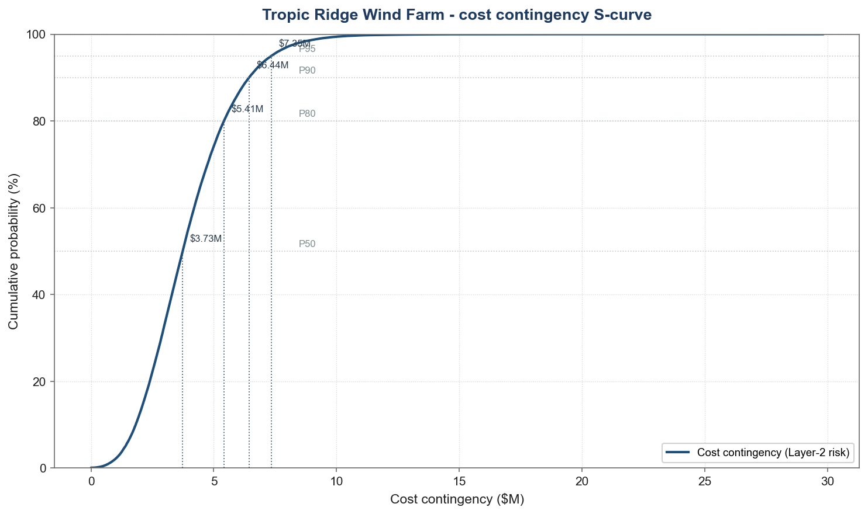
THE OUTPUTS
Reading the S-curve
HOW TO READ IT
The curve is the probability the cost contingency lands at or below a given amount.
It rises steeply, then trails into a long thin tail: most outcomes cluster low, a few run high.
Pick a confidence level and read the contingency straight off the curve.
P50
$3.73M
7.5% of capex
P80
$5.41M
10.8% of capex
P90
$6.44M
12.9% of capex
Tropic Ridge Wind Farm, illustrative. 35 risks, 100,000 iterations, seed 42.
Contingency on the $50M Tropic Ridge capex (Layer-2 risk).
Monte Carlo cost risk analysis
8
Notes:
Cost contingency S-curve from the production run (seed 42, 100k iterations). Read the contingency at any confidence level: P50 3.73M, P80 5.41M, P90 6.44M, on the 50M capex. Steep rise then a thin right tail.

Slide 9
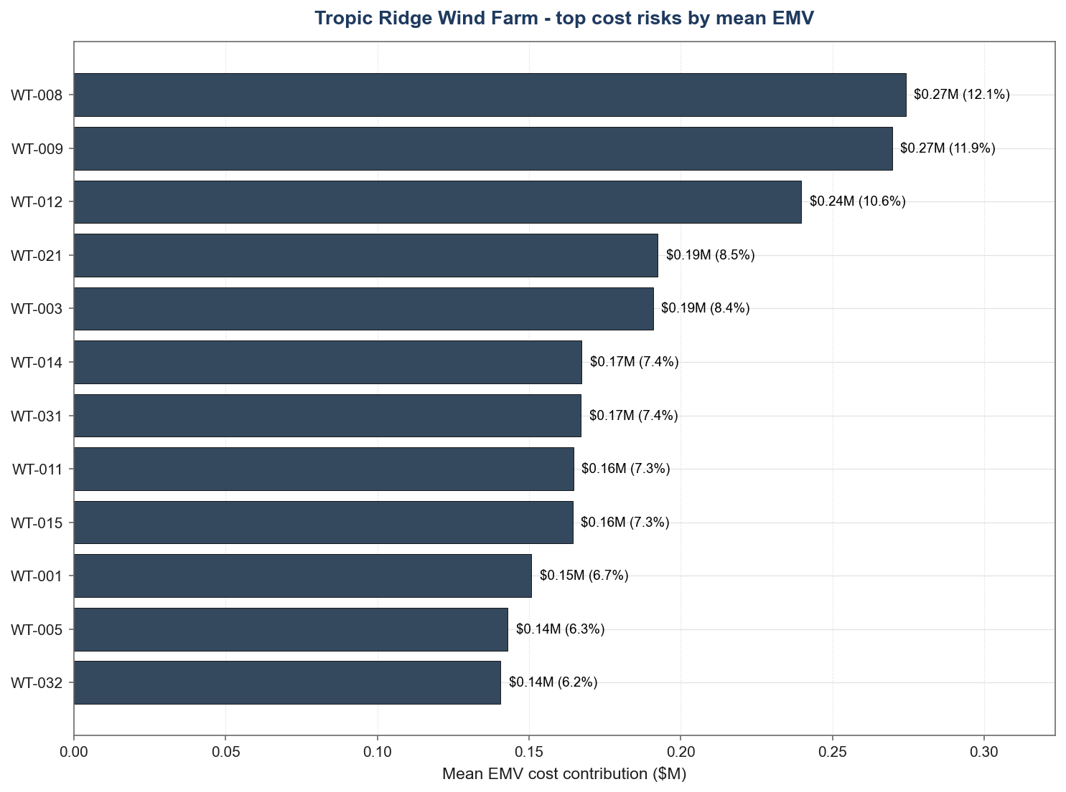
THE OUTPUTS
P-values and the risk tornado
TOP COST RISKS BY MEAN EMV
Metric | Contingency | % of $50M capex
Mean | $3.98M | 8.0%
P50 | $3.73M | 7.5%
P80 | $5.41M | 10.8%
P90 | $6.44M | 12.9%
P95 | $7.35M | 14.7%
Whole-project cost contingency (Layer-2 risk), Tropic Ridge illustrative run.
The same run is filtered by risk owner to give Owner, EPC Contractor and whole-project views. Shared risks are split 50/50 by default (a parameter, not a hard-code) and counted once in the whole-project total, so the party views must never simply be added together.
Monte Carlo cost risk analysis
9
Notes:
Left: whole-project cost contingency P-bands from the production run (P80 5.41M, 10.8% of the 50M capex). Right: engine tornado ranking risks by mean EMV, led by WTG delivery and crane mobilisation. Owner and EPC views come from filtering the same run by owner; shared risks split 50/50 and count once at whole-project level.

Slide 10
CROSS-CHECK
Grounded by a deterministic cross-check
Before trusting the simulation, its expected cost is reconciled to a simple expected monetary value (EMV) calculation that anyone can verify with a calculator.
P90
P80
MC mean
EMV PERT-weighted
EMV simple
Distribution shape
Correlation and chaining uplift
Tail risk margin
If the EMV and the MC mean broadly agree, the simulation is consistent with the underlying register. The Monte Carlo then adds the tail information, the P80 and P90, that a deterministic method cannot provide.
Monte Carlo cost risk analysis
10
Notes:
Bridge from a hand-checkable EMV to the simulated mean and on to the P80 and P90. No dollar values shown; the shape of the bridge is the message.

Slide 11
THE DECISION
Contingency sized from evidence
1
Choose a P-level
P-LEVEL CONVENTIONS
A commercial confidence level, typically P50, P80 or P90.
P90
Lenders and boards: high confidence that funding is not exceeded.
2
Read the cost at that percentile
Taken directly from the simulated S-curve.
P80
A common contractor convention.
3
Contingency = that cost minus the P50
P50
The unbiased estimate, as likely to overrun as underrun.
The margin above the unbiased estimate needed to reach the chosen confidence.
The P-level is a commercial decision, not a technical output. The model prices each option so the parties can negotiate with evidence.
Monte Carlo cost risk analysis
11
Notes:
Contingency is read off the curve: pick a P-level, read the cost, subtract the P50. The choice of P-level is commercial; the model prices each option.

Slide 12
COST AND SCHEDULE TOGETHER
The two arms, sampled jointly
Cost and schedule are not independent. Ten risks in the register hit both arms. The integrated engine draws one severity per risk per iteration and applies it to cost and time together, so the combined contingency prices the overlap that two separate models cannot see.
Component (P80) | Contingency | % of $50M
Cost QRA (Layer-2 risk) | $5.41M | 10.8%
Schedule (Stage 3 CPM @ $35k/day) | $1.88M | 3.8%
Integrated total (joint) | $6.84M | 13.7%
Naive sum (P80 + P80) | $7.29M | 14.6%
INTEGRATED P80 (JOINT)
$6.84M
13.7% of the $50M capex
$0.45M lower than adding the two P80s. The P80 of a sum is not the sum of P80s; the joint model prices the diversification the naive add-up ignores.
Integrated joint contingency Mean $5.29M · P50 $5.06M · P80 $6.84M · P90 $7.90M · P95 $8.87M
Schedule arm on the Stage 3 CPM basis: P80 finish delay 53.6 working days, dollarised at $35,000/day. Illustrative Tropic Ridge run, seed 42, 100,000 iterations.
Monte Carlo cost risk analysis
12
Notes:
The integrated engine jointly samples cost and the Stage 3 schedule: 10 dual-coded risks share one severity draw per iteration. Joint P80 is 6.84M (13.7% of capex), which is 0.45M below the naive cost-P80-plus-schedule-P80 sum of 7.29M because the P80 of a sum is not the sum of P80s. This is the bridge to the companion schedule deck.

Slide 13
TRUST
Built to be audited, not believed
Single-run inspector
Configuration disclosure
Any one iteration can be shown in full: which events fired, what each cost, and which chains triggered. Rerun it live to build intuition without statistics.
Every report states the active settings: seasons, chains, cascading and the correlation source. No hidden switches.
Reproducible
Tested
Runs are seeded. The same inputs always give the same numbers, and every output carries a run fingerprint.
An automated test suite runs on every change. Nothing ships on a red build.
Monte Carlo cost risk analysis
13
Notes:
Four trust mechanisms: single-run inspection, full configuration disclosure, seeded reproducibility with run fingerprints, and an automated test suite gating every change.

Slide 14
IN SUMMARY
Evidence-based contingency from a living risk register
1
One curve, three answers
A realistic cost range, an evidence-based contingency, and a ranked list of the risks that matter.
THE TWO ARMS
This deck is the cost arm.
The companion deck forecasts the schedule: the P80 finish date.
The two can be sampled jointly, one register, one auditable engine.
2
Behaviour lives in the register
Correlation, chaining, recurrence and ownership are inputs a risk team can see and change.
3
Auditable end to end
Deterministic cross-check, single-run inspector, and seeded reproducible outputs.
SJP Consulting · CBL Analytics | July 2026
Notes:
Summary: one curve gives the range, the contingency and the ranked risks; behaviour is register-driven; everything is auditable. Companion schedule deck covers the date arm.

